Slide 1
AN INTERNAL INTRUSION DETECTION AND PROTECTION SYSTEM USING DATA MINING AND FORENSIC TECHNIQUES
G. Sharath Chandra
S. Praneetha Reddy
Dept. of Computer Science,
Mahatma Gandhi Institute of Technology.
Guide:
Ms. Ankita

Slide 2
AGENDA:
Abstract
Existing System and Drawbacks
Proposed System
Architecture
Modules
H/W and S/W requirements

Slide 3
Abstract:
Currently, most computer systems use user IDs and passwords as the login pattern to authenticate users.
Sharing credentials may cause security issues.
It is impossible to detect insider attacks when the user is an authenticated one.
.

Slide 4
EXISTING SYSTEM PROPOSED SYSTEM
Increasing processing speeds increase vulnerability for penetration.
EXISTING TECHNIQUES:
Firewalls and intrusion detection systems
We propose a security systems named IIDPS which detects malicious behaviour, launched at a SC level.
PROPOSED TECHNIQUES:
Forensic Techniques
Data Mining

Slide 5
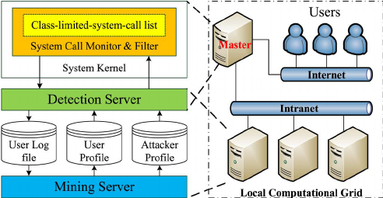

Slide 6
Modules:
Adding Employees
Monitoring the system calls and visualizing their activities
Blocking the employees
Encryption and Decryption

Slide 7
requirements:
HARDWARE:
Processor: Intel Pentium or above
RAM: at least 4GB for optimum performance
SOFTWARE:
Operating System: Windows 7 or above
Front- end: HTML, CSS, Bootstrap, JavaScript
Back-end: Python Django framework
Database: MySQL database

Slide 8
References:
“An Internal Detection and Protection System using Data Mining and Forensic Techniques”, Fang-Yie Leu, Kun-Lin Tsai.
M. K. Rogers and K. Seigfried, “The future of computer forensics: A needs analysis survey,” Comput. Security, vol. 23, no. 1, pp 12-16, Feb, 2004.

Slide 9
QUERIES?

Slide 10
THANK YOU

